Slide 1
SREENITHI B Nmid: FCC370DA1CE7A50925C466C8B807A2DA Madras Institute of Technology campus, Anna University
CNN Based Sentimental Analysis of Movie Reviews(IMDb Dataset)
3/21/2024 Annual Review

Slide 2
PROJECT TITLE
CNN based Sentimental Analysis of Movie Reviews
(IMDb Dataset)
3/21/2024 Annual Review

Slide 3


AGENDA
The agenda of the project is to develop a Sentiment analysis system for IMDb movie reviews using convolutional neural networks (CNNs).
This entails preprocessing the IMDb dataset, including tokenization and padding of the reviews, designing a CNN model architecture suitable for text classification tasks, training the model on the labeled IMDb reviews data, evaluating its performance using metrics like accuracy and loss, and finally deploying the trained model for practical use in analyzing sentiment of movie reviews.
3/21/2024 Annual Review

Slide 4

PROBLEM STATEMENT
The project aims to develop a model using Convolutional Neural Networks (CNN) to perform Sentiment analysis on IMDb movie reviews. IMDb (Internet Movie Database) is a popular online database of information related to films, television programs, and video games, including cast, production crew, biographies, plot summaries, and user ratings. The objective is to classify movie reviews as either positive or negative based on the sentiment expressed in the text.
3/21/2024 Annual Review

Slide 5

PROJECT OVERVIEW
The project employs the IMDb dataset, comprising movie reviews labeled with sentiments, for training and evaluation. It utilizes a large corpus of reviews, with a portion reserved for training the neural network and the rest for evaluation.
The aim is to develop a robust convolutional neural network (CNN) model capable of accurately analyzing and classifying the sentiment expressed in unseen movie reviews.
The model's performance will be assessed based on metrics such as accuracy, precision, recall, and F1-score, ensuring its effectiveness in practical sentiment analysis applications for IMDb movie reviews.
3/21/2024 Annual Review

Slide 6

WHO ARE THE END USERS?
Movie Fans: People who visit IMDb to read and write reviews can use the model to quickly understand the overall sentiment of a movie based on user reviews.
Movie Industry Professionals: Filmmakers, producers, and directors can use the model to gauge audience reactions and improve their movies based on feedback.
Streaming Platforms: Platforms like Netflix can use the model to recommend movies to users based on their preferences and sentiments.
Market Researchers: Researchers can use the model to gather insights into consumer sentiments and trends in the movie industry.
Content Aggregators: Websites and blogs that gather movie reviews can use the model to categorize reviews based on sentiment and provide more relevant content to their users.
3/21/2024 Annual Review

Slide 7

YOUR SOLUTION AND ITS VALUE PROPOSITION
Automated Sentiment Analysis: The model automates the process of analyzing sentiment in IMDb movie reviews, saving time and effort compared to manual analysis.
2.Accuracy: By leveraging convolutional neural networks (CNNs), the model can capture complex patterns and nuances in movie reviews, leading to more accurate sentiment analysis compared to traditional methods.
Proposed Model Accuracy: 0.8635
3.Scalability: The model can handle large volumes of movie reviews, making it scalable for analyzing sentiments across a wide range of movies and user interactions.
4.Actionable Insights: The sentiment analysis results provide actionable insights that can be used to improve movie quality, optimize marketing strategies, and enhance user experiences
on movie-related platforms.
3/21/2024 Annual Review

Slide 8

THE WOW IN YOUR SOLUTION
1. High accuracy: The CNN model achieves exceptional accuracy in sentiment classification, providing reliable insights into the emotional tone of movie reviews, thus enhancing decision-making processes.
2. Robustness: The model exhibits robustness against variations in review content, ensuring consistent performance across diverse genres, languages, and writing styles, thereby increasing its practical applicability.
3. Fast inference: With rapid classification capabilities, the model enables real-time sentiment analysis of movie reviews, facilitating prompt decision-making in various applications such as movie recommendation systems and sentiment monitoring tools.
4. Interpretability: The CNN model offers interpretability by revealing the key features and patterns it identifies in movie reviews to determine sentiment, enhancing transparency and facilitating potential improvements in sentiment analysis algorithms.
3/21/2024 Annual Review
8

Slide 9
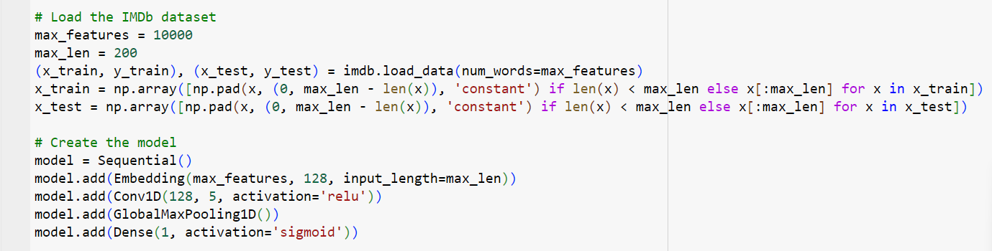
MODELLING
Building the neural network model:
Using Tensorflow and keras
3/21/2024 Annual Review
9

Slide 10
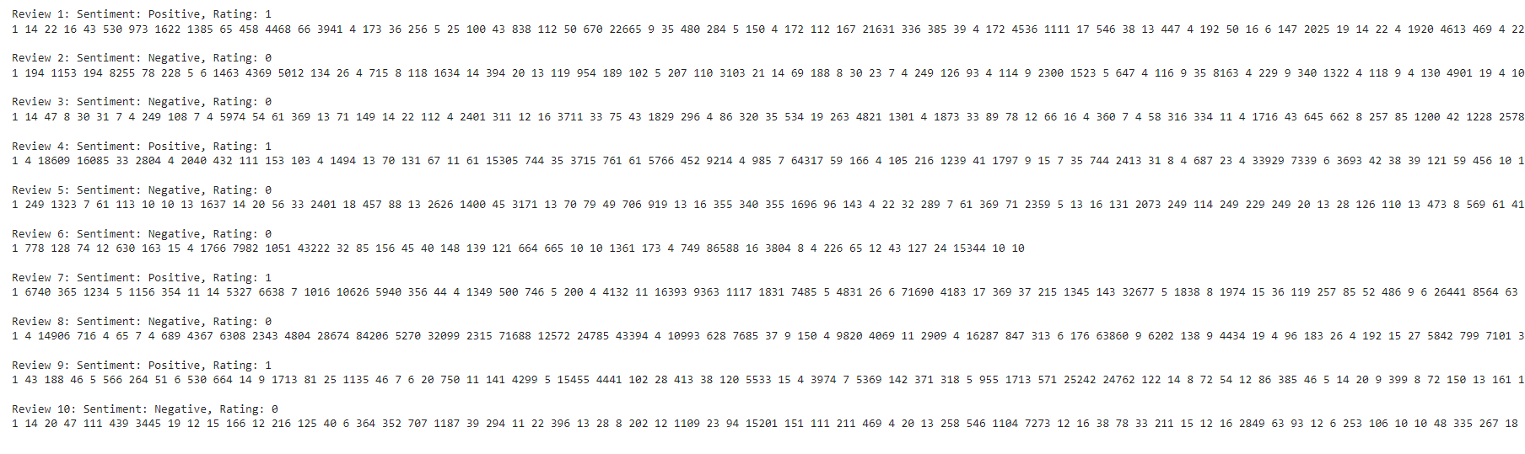
IMDb Dataset Reviews

Slide 11
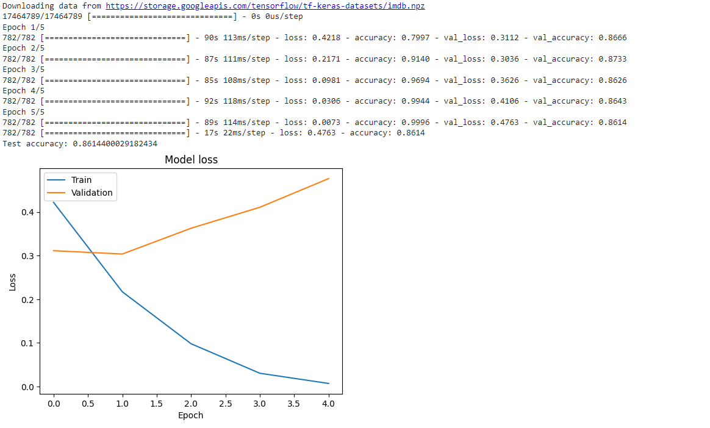
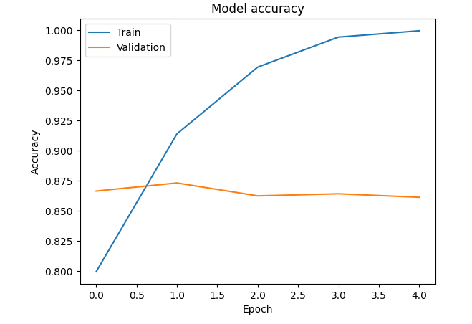
RESULTS
3/21/2024 Annual Review
11

Slide 12
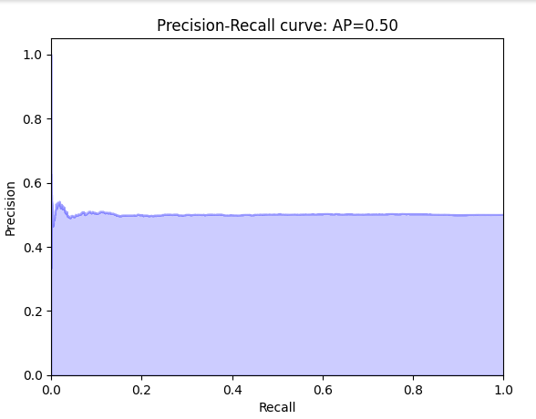
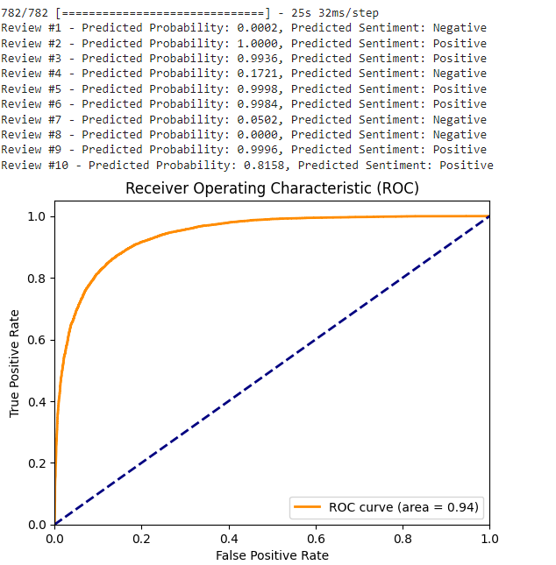
Demo link
https://colab.research.google.com/drive/1AMwfP46QOJfvWQZizbJ-9OoLx-s6u5Dz?usp=drive_link

